Slide 1
Recurrent Neural Networks
Introduction to Recurrent Neural Networks
Architecture of RNNs
Applications of RNN
Challenges in RNNs (Vanishing Gradient Problem)
Types Of Recurrent Neural Networks

Slide 2
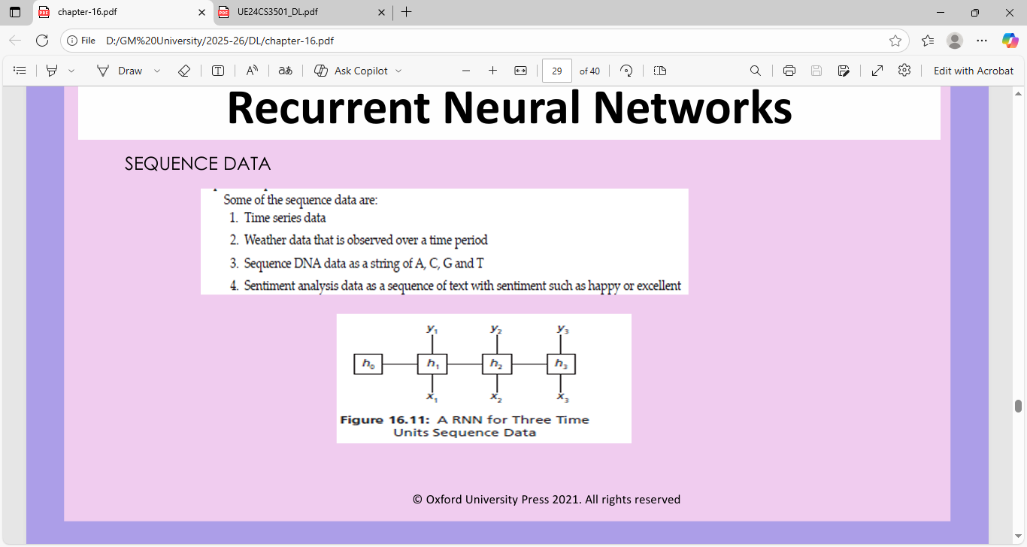
A recurrent neural network (RNN) is a type of neural network specifically designed to process sequential data, like text, speech, or time series, by retaining information from previous steps in the sequence to influence the current step

Slide 3
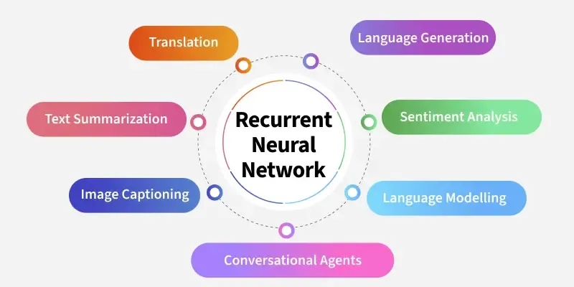

Slide 4
Recurrent Neural Networks (RNNs) differ from regular neural networks in how they process information. While standard neural networks pass information in one direction i.e. from input to output, RNNs feed information back into the network at each step.
Imagine reading a sentence and you try to predict the next word, you don’t rely only on the current word but also remember the words that came before. RNNs work similarly by “remembering” past information and passing the output from one step as input to the next

Slide 5
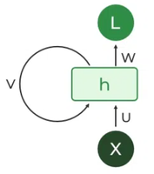
Key Components of RNNs
There are mainly two components of RNNs
1. Recurrent Neurons
The fundamental processing unit in RNN is a Recurrent Unit.
They hold a hidden state that maintains information about previous inputs in a sequence.
Recurrent units can "remember" information from prior steps by feeding back their hidden state, allowing them to capture dependencies across time.

Slide 6
2. RNN Unfolding
RNN unfolding or unrolling is the process of expanding the recurrent structure over time steps.
During unfolding each step of the sequence is represented as a separate layer in a series illustrating how information flows across each time step.
Backpropagation through time (BPTT) a learning process where errors are propagated across time steps to adjust the network’s weights enhancing the RNN’s ability to learn dependencies within sequential data.

Slide 7
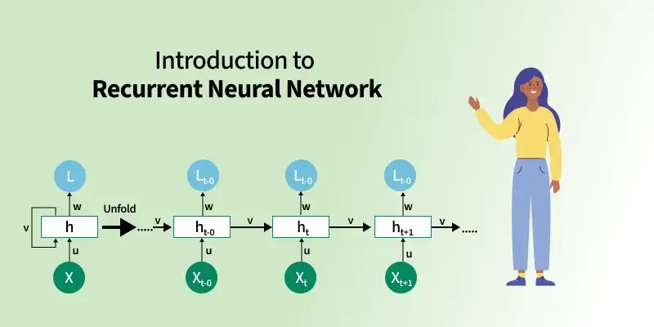

Slide 8
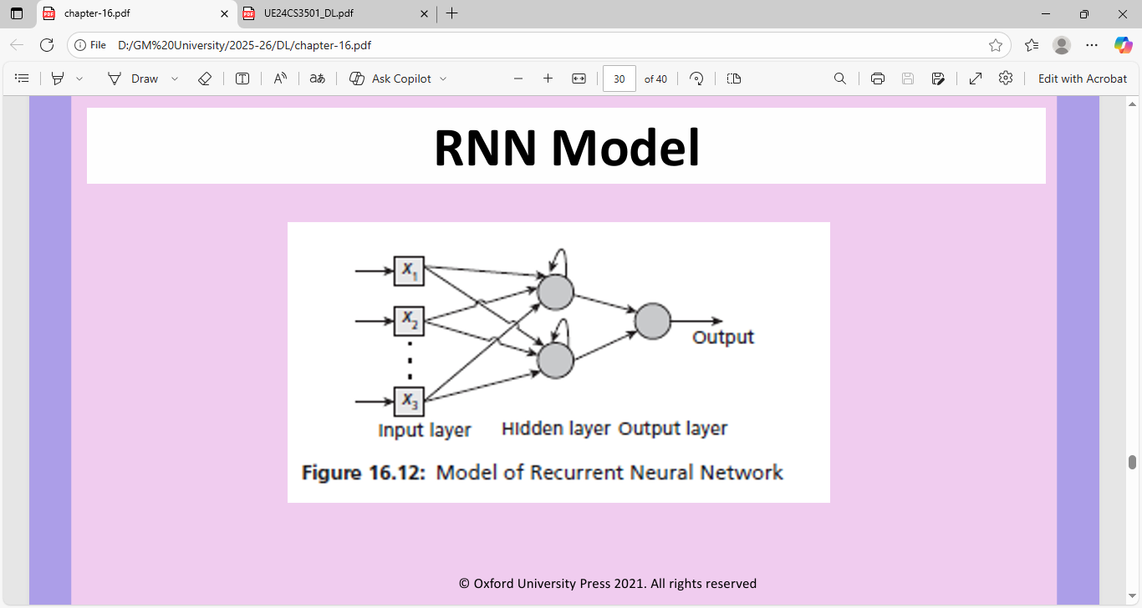

Slide 9
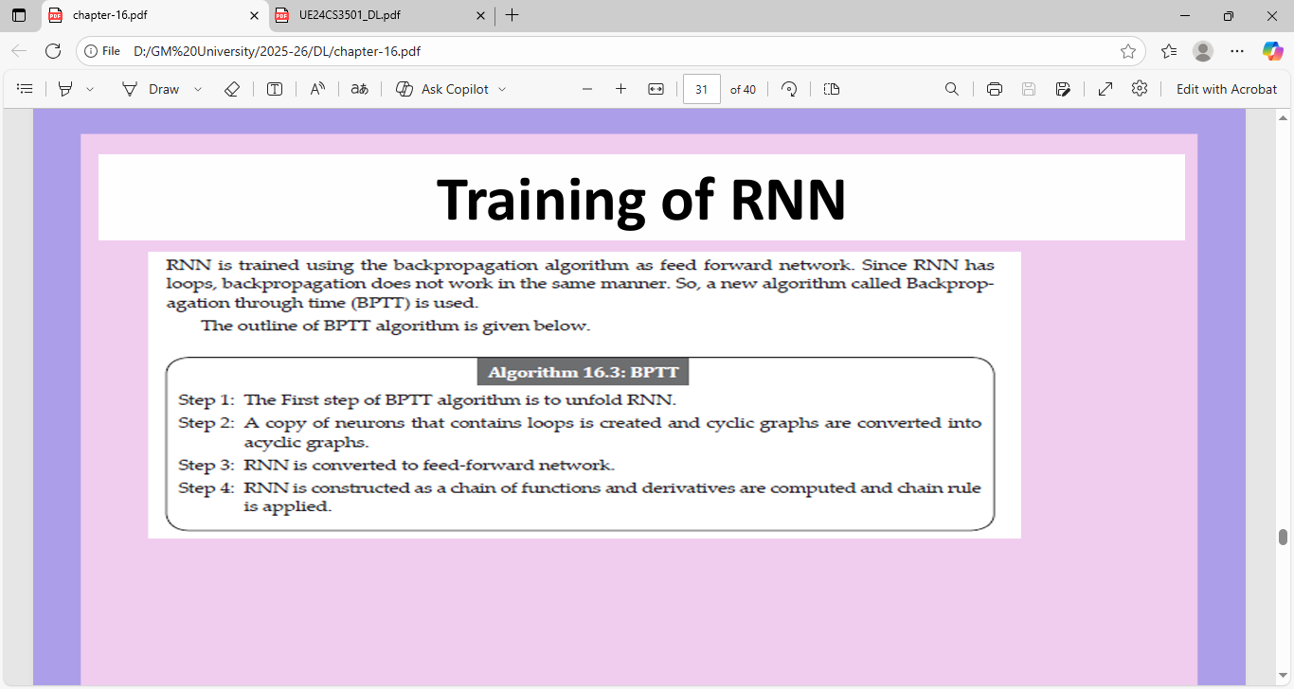

Slide 10

Architecture of RNNs
In RNNs the hidden state Hi is calculated for every input Xi​​ to retain sequential dependencies.
Input Layer
  Takes sequential data as input.
Hidden Layer with Recurrent Connections
  Core part of the RNN.

Slide 11
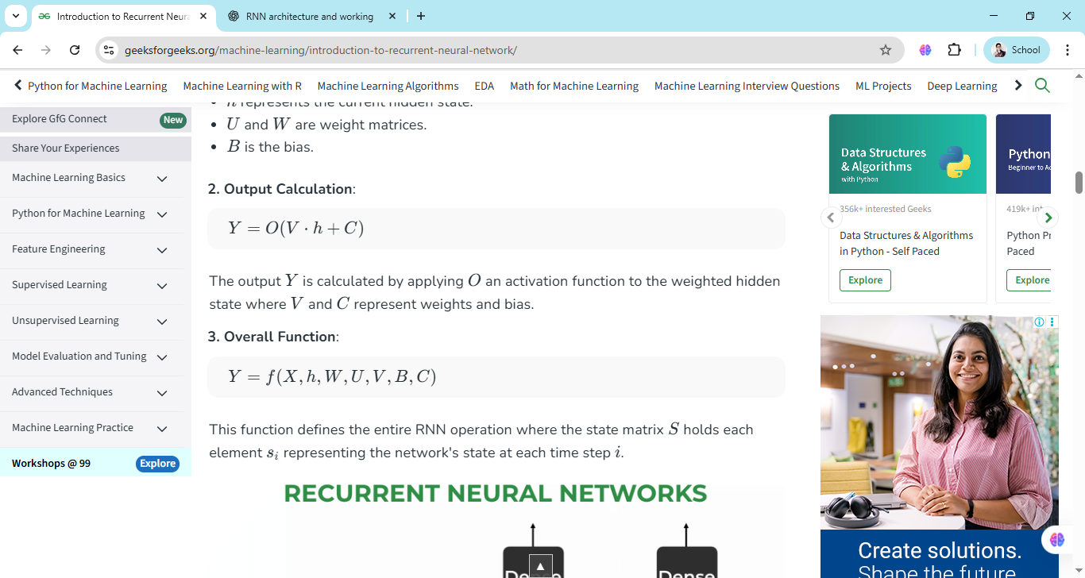
Output Calculation: The output Y is calculated by applying OO an activation function to the weighted hidden state where V and C represent weights and bias.
Overall Function: This function defines the entire RNN operation where the state matrix S holds each element si representing the network's state at each time step i

Slide 12
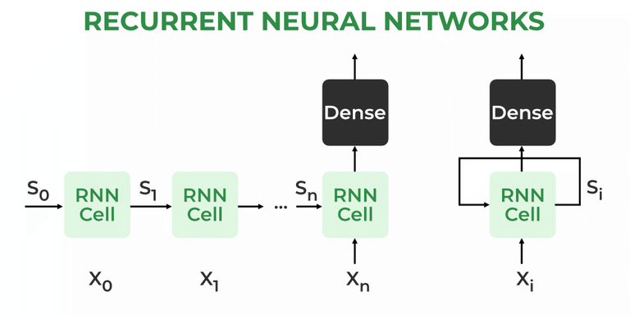
At each time step RNNs process units with a fixed activation function.
These units have an internal hidden state that acts as memory that retains information from previous time steps.
This memory allows the network to store past knowledge and adapt based on new inputs.

Slide 13
Types Of Recurrent Neural Networks
There are four types of RNNs based on the number of inputs and outputs in the network
  One-to-One RNN
  One-to-Many RNN
  Many-to-One RNN
  Many-to-Many RNN

Slide 14
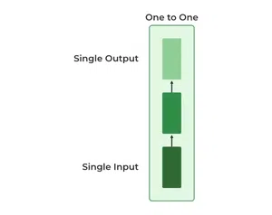
  One-to-One RNN
  This is the simplest type of neural network architecture where there is a single input and a single output.
  It is used for straightforward classification tasks such as binary classification where no sequential data is involved.

Slide 15
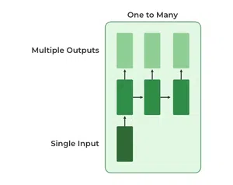
One-to-Many RNN
  In a One-to-Many RNN the network processes a single input to produce multiple outputs over time.
  This is useful in tasks where one input triggers a sequence of predictions (outputs).
  For example in image captioning a single image can be used as input to generate a sequence of words as a caption.

Slide 16
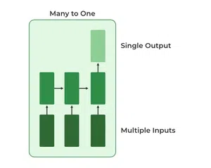
Many-to-One RNN
  The Many-to-One RNN receives a sequence of inputs and generates a single output.
  This type is useful when the overall context of the input sequence is needed to make one prediction.
  In sentiment analysis the model receives a sequence of words (like a sentence) and produces a single output like positive, negative or neutral.

Slide 17
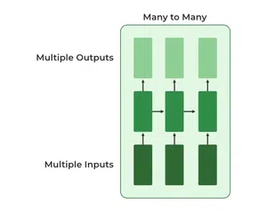
Many-to-Many RNN
  The Many-to-Many RNN type processes a sequence of inputs and generates a sequence of outputs.
  In language translation task a sequence of words in one language is given as input and a corresponding sequence in another language is generated as output.

Slide 18
Variants of Recurrent Neural Networks
Vanilla RNN
  This simplest form of RNN consists of a single hidden layer where weights are shared across time steps.
  Vanilla RNNs are suitable for learning short-term dependencies but are limited by the vanishing gradient problem, which hampers long-sequence learning.
Bidirectional RNNs
  A Bidirectional Recurrent Neural Network (BRNN) is an extension of the traditional RNN that processes sequential data in both forward and backward directions

Slide 19
The key difference is that a BRNN also has a backward hidden layer which processes the sequence in reverse, updating the hidden state based on the current input and the hidden state of the next time step.
BRNNs improve accuracy by considering both the past and future context. This is because the two hidden layers i.e forward and backward complement each other and predictions are made using the combined outputs of both layers.
Example:
Consider the sentence: "I like apple. It is very healthy."

Slide 20
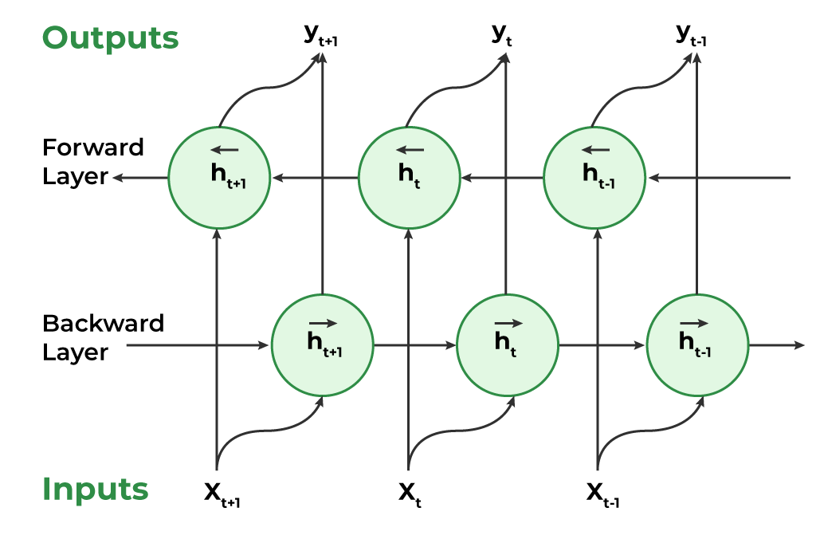

Slide 21
Working of Bidirectional Recurrent Neural Networks
Inputting a Sequence: A sequence of data points each represented as a vector with the same dimensionality is fed into the BRNN.
Dual Processing: BRNNs process data in two directions:
  Forward direction: The hidden state at each time step is determined by the current input and the previous hidden state.
  Backward direction: The hidden state at each time step is influenced by the current input and the next hidden state.

Slide 22
Computing the Hidden State: A non-linear activation function is applied to the weighted sum of the input and the previous hidden state creating a memory mechanism that allows the network to retain information from earlier steps.
Determining the Output: A non-linear activation function is applied to the weighted sum of the hidden state and output weights to compute the output at each step. This output can either be:
  The final output of the network.
  An input to another layer for further processing.

Slide 23
LSTM (Long Short-Term Memory)
LSTM (Long Short-Term Memory) is a type of recurrent neural network (RNN) in deep learning that is specifically designed to handle sequential data by using a memory cell and a system of gates to selectively remember or forget information over long periods.
LSTM architectures involves the memory cell which is controlled by three gates:
  Input gate: Controls what information is added to the memory cell.
  Forget gate: Determines what information is removed from the memory cell.
  Output gate: Controls what information is output from the memory cell.

Slide 24
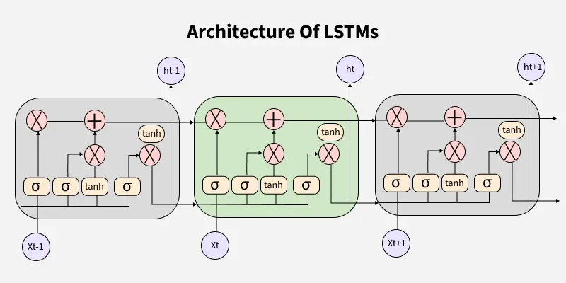

Slide 25
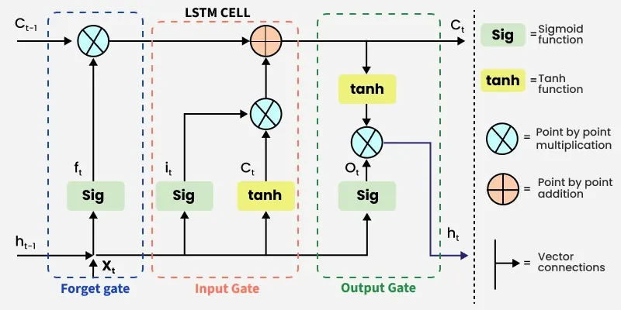

Slide 26
Memory Cell: This is the core of the LSTM. It has two states that are passed from one time step to the next:
  Cell State: Carries the "long-term memory," a running summary of all past information.
  Hidden State: Carries the "short-term memory," which is the output of the last time step.

Slide 27
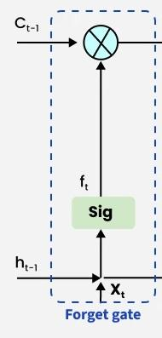
Forget Gate :
  The information that is no longer useful in the cell state is removed with the forget gate.
  Two inputs xt​ (input at the particular time) and ht−1​ (previous cell output) are fed to the gate and multiplied with weight matrices followed by the addition of bias.
  The resultant is passed through sigmoid activation function which gives output in range of [0,1].
  If for a particular cell state the output is 0 or near to 0, the piece of information is forgotten and for output of 1 or near to 1, the information is retained for future use.

Slide 28
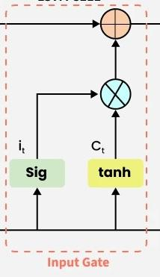
Input Gate :
  The addition of useful information to the cell state is done by the input gate.
  First the information is regulated using the sigmoid function and filter the values to be remembered similar to the forget gate using inputs ht−1​ and xt​.
  Then, a vector is created using tanh function that gives an output from -1 to +1 which contains all the possible values from ht−1​ and xt​.
  At last the values of the vector and the regulated values are multiplied to obtain the useful information.

Slide 29
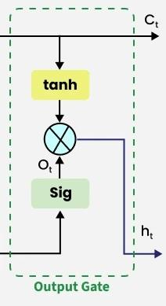
Output gate
The output gate is responsible for deciding what part of the current cell state should be sent as the hidden state (output) for this time step.
First, the gate uses a sigmoid function to determine which information from the current cell state will be output.
This is done using the previous hidden state ht−1​​ and the current input xt
Next, the current cell state Ct is passed through a tanh activation to scale its values between −1 and +1.
Finally, this transformed cell state is multiplied element-wise with ot to produce the hidden state ht

Slide 30
Example: Sentence completion
Imagine an LSTM is trained to complete sentences.
Input: "The cat sat on the..."
Processing:
  The LSTM processes each word one by one. When it sees "The," it might store this as a potential subject.
  When it sees "cat," it knows this is the subject. It uses the forget gate to decide if it needs to hold onto information about the previous word ("The").
  When it sees "sat," it can use the information from the "cat" to decide that a singular subject is followed by a singular verb. It stores this context in its memory cell.
Prediction: The LSTM is ready to predict the next word. Based on the "long-term memory" of a singular subject ("cat") and the "short-term memory" of the last word ("sat"), it is likely to predict a location, such as "mat," "chair," or "sofa".

Slide 31
Gated Recurrent Units (GRUs)
The core idea behind GRUs is to use gating mechanisms to selectively update the hidden state at each time step allowing them to remember important information while discarding irrelevant details.
GRUs aim to simplify the LSTM architecture by merging some of its components and focusing on just two main gates: the update gate and the reset gate. The GRU consists of two main gates:
Update Gate (ztzt​​): This gate decides how much information from previous hidden state should be retained for the next time step.
Reset Gate (rtrt​​): This gate determines how much of the past hidden state should be forgotten.

Slide 32
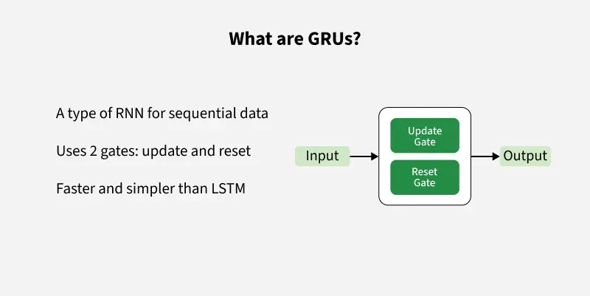
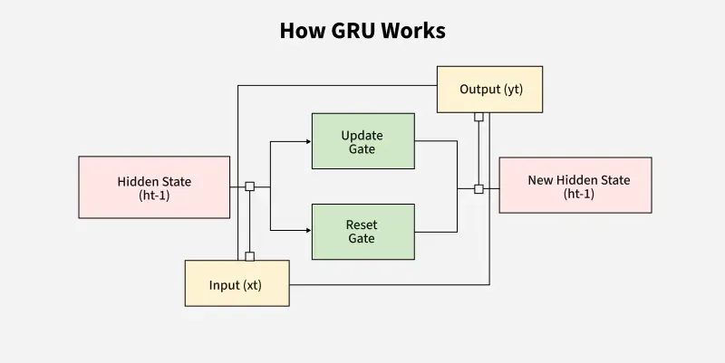

Slide 33
Feature | LSTM (Long Short-Term Memory) | GRU (Gated Recurrent Unit)
Gates | 3 (Input, Forget, Output) | 2 (Update, Reset)
Cell State | Yes it has cell state | No (Hidden state only)
Training Speed | Slower due to complexity | Faster due to simpler architecture
Computational Load | Higher due to more gates and parameters | Lower due to fewer gates and parameters
Performance | Often better in tasks requiring long-term memory | Performs similarly in many tasks with less complexity

